Slide 1

Natural Language Processing Engine For On-The-Go Application
By: Muhammad Hadi Asyrafi Bin Abdul Halim
Supervisor: Dr. Musa Bin Mohd Mokji
Programme: 4 SKEL

Slide 2

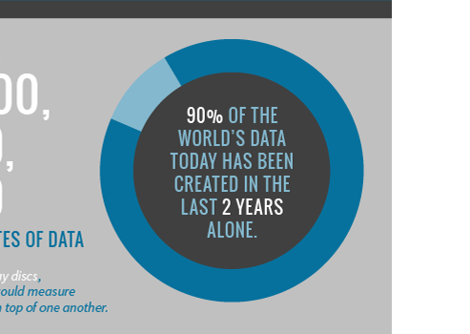
INTRODUCTION
SINTEF. "Big Data: for better or worse: 90% of world's data generated over last two years.“
ScienceDaily. ScienceDaily, 22 May 2013.

Slide 3
INTRODUCTION
Motivation
“If structured data is big, then unstructured data is huge.
The generally accepted maxim is that structured data represents only 20% of the information available to an organization.
That means that 80% of all data is in unstructured form”
  This is both a blessing and a curse
  This huge amount of data are seemingly impossible for human to handle
  Computers are generally not good in understanding human language
  Importance of this emerging field of Natural Language Processing
Daniel Gutierrez - Text Analytics : The Next Generation of Big Data

Slide 4


PROBLEM STATEMENT
“How to ease user reading task and improving their knowledge extraction from textual document using automated Natural Language Processing (NLP) for on-the-go application”

Slide 5
OBJECTIVES
Apply NLP to ease everyday reading task
Reduce time consumption of traditional reading method while improving the overall efficiency
Automate language-related task that are commonly done manually by human before
Intuitive and easy to use Language Processing features for on-the-go users

Slide 6

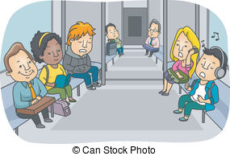




SCOPES OF PROJECT
Target Users:
Commuters
Students
Extremely Useful
Time Constraints
& Tardiness
Text are Large
Plain Lazy

Slide 7

SCOPES OF NATURAL LANGUAGE PROCESSING
Machine Translation Automatic Summarization
Sentiment Analysis Text Classification
Natural Language Understanding Natural Language Generation
Keyword Extraction Speech Recognition Machine Q & A
Optical Character Recognition
Name-Entity Recognition Language Detection

Slide 8
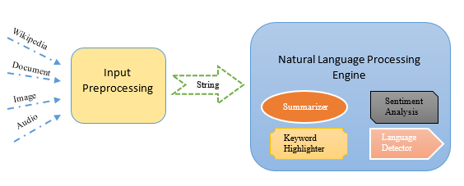
METHODOLOGY
User Interface

Slide 9

INPUT PREPROCESSING
Category | File Type | File Extension
Wikipedia | Hypertext Markup Language | .html
Document | Text File | .txt
 | Power Point Presentation | .pptx
 | Portable Document Format | .pdf
 | Word Document | .doc .docx
 | Open Document Text | .odt
Image | Portable Network Graphic | .png
 | Graphic Interchange Format | .gif
 | Joint Photographic Expert Group | .jpg .jpeg
Audio | MPEG Audio Layer-3 | .mp3
 | WAVE Audio Format | .wav
 | OGG Vorbis File Format | .ogg

Slide 10


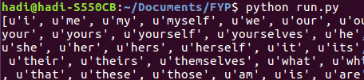
NLP ENGINE
Natural Language Tool Kit (NLTK)
Tokenization
POS-Tagging
Stop-Words

Slide 11



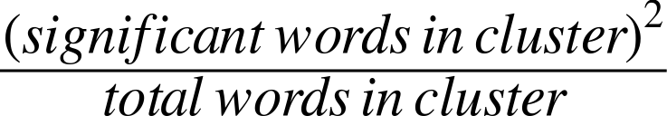
AUTOMATIC SUMMARIZATION
Summarize by sentences
Important sentences Contain frequently occurring words
Stop-words Important words
Cluster scoring
Sentence scoring
Filter sentences (mean, standard deviation)

Slide 12
KEYWORDS HIGHLIGHTING
Tokenization
POS-Tagging
Nouns Extraction

Slide 13

SENTIMENT ANALYSIS
Dictionaries:
Steps:
Tokenization
Word Matching
Sentiment Scoring
Scoring:
Positive = 1
Negative = 1
Increment = Score * 2
Decrement = Score * 0.5
Inverse = - Score

Slide 14

LANGUAGE DETECTION
Tokenization
Cross-Refencing
Language Choosing
* 14 available language stop-words

Slide 15
GANTT CHART
No | Task | 2016
 |  | September |  |  |  | October |  |  |  | November |  |  |  |  | December
 |  | 1 | 2 | 3 | 4 | 1 | 2 | 3 | 4 | 1 | 2 | 3 | 4 | 5 | 1 | 2 | 3 | 4
1 | Literature Review
2 | Automatic Summarization
3 | Sentiment Analysis
4 | Language Detection

Slide 16
GANTT CHART
No | Task | 2017
 |  | January |  |  |  | February |  |  |  | March |  |  |  |  | April
 |  | 1 | 2 | 3 | 4 | 1 | 2 | 3 | 4 | 1 | 2 | 3 | 4 | 5 | 1 | 2 | 3 | 4
5 | Keyword Highlighting
6 | Input Preprocessing
7 | Project Analysis
8 | GUI

Slide 17
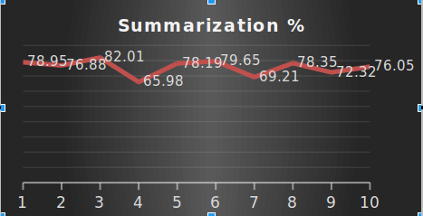
ANALYSIS
10 BBC news article retrieved
Average summarization = 75.76%

Slide 18
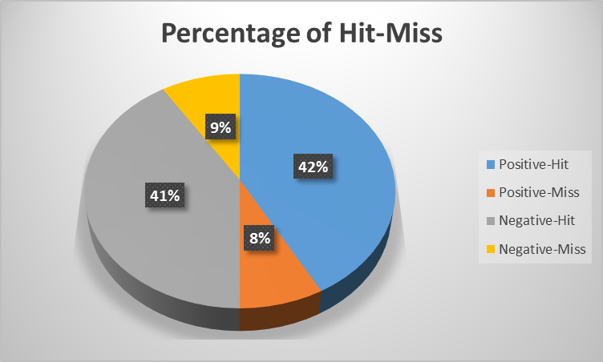
ANALYSIS
50 positive and 50 negative movie reviews extracted from imdb.com.
Review with star < 5 is considered negative, while star > 6 is considered positive.
Average Hit of 83% accounting for both

Slide 19














ANALYSIS
100% 100% 100% 100% 100% 100% 100%
100% 100% 100% 100% 100% 100% 100%
1st Row: Danish, Dutch, English, Finnish, French, German, Hungarian
2nd Row: Italian, Malay, Norwegian, Portuguese, Spanish, Swedish, Turkish

Slide 20
LITERATURE REVIEW
No. | Title | Description | Source
1. | Latent Topic-Semantic Indexing Based Automatic Text Summarization | - Machine Learning Method - Bayesian Model of Topic Semantic Indexing (TSI) | 15th IEEE International Conference, 18-20 Dec. 2016
2. | Automatic text summarization using fuzzy inference | - Fuzzy logic with traditional extractive and abstractive approaches | 22nd International (ICAC), 7-8 Sept. 2016
3. | Automatic Document Summarization via Deep Neural Networks | - Deep Neural Networks - Sentences extraction algorithm to construct the summary | 8th International Symposium (ISCID), 12-13 Dec. 2015
4. | Automatic Summarization of News Articles in Mobile Devices | - Multi-feature language independent summarization | 14th Mexican International Conference (MICAI), 25-31 Oct. 2015

Slide 21
LITERATURE REVIEW
No. | Title | Description | Dataset | Accuracy
1. | Sentiment analysis of movie review data using Senti-lexicon algorithm | - Senti-lexical algorithm | 300 Movie Reviews | 70.67 %
2. | Application of machine learning techniques to sentiment analysis | - Machine learning - Naïve Bayes - Decision trees | 600 Tweets per technique | 77.15 % 99.20 %
1. | Totally automated keyword extraction | - Candidate keyword extraction - Filter candidate keywords - Feature calculation of candidate keywords - Selection using the threshold function | 500 abstracts | 50.40 %
2. | Research on keyword extraction based on Word2Vec weighted TextRank | - Graph model based on TextRank - Word2Vec to calculate the similarity between words - calculate the word score by iterative method - Pick the top N of the candidate keywords | 500 articles | 33.30 %

Slide 22


FUTURE WORKS
Scale Web-scraper to cover other websites
Improve algorithm
    Understand language on deeper semantic level
Add more NLP features
    Machine Translation
Dedicated processing unit for NLP

Slide 23
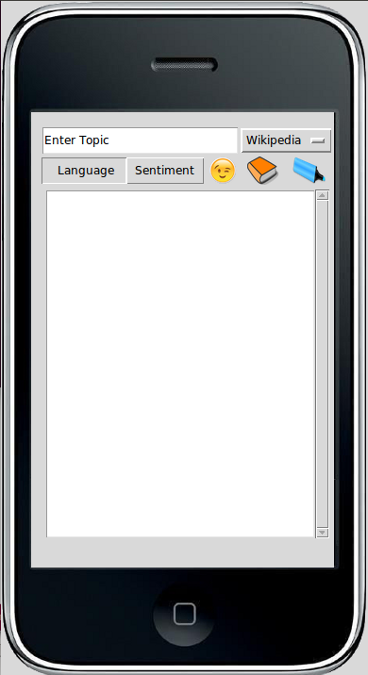
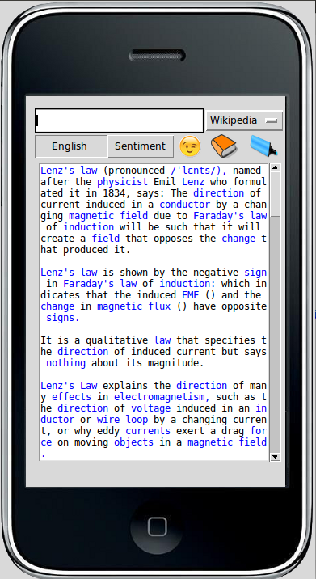
Q & A

